Slide 1
Lab 3 Presentation
GG4257: Urban Analytics

Slide 2
Crime Rates and Transportation Hubs
Problem
Washington D.C. has the highest crime rate per 100,000 people in the United States.
Many people are reliant on the Metro, or the underground train, to commute to work and travel.
There is a gap in the knowledge on how transportation hubs, such as Metro Station Entrances, affect crime rates in D.C.
Is there a relationship between the size of the Metro Station and the density of crimes?
Dataset
Approx. 27000 data points published by the city for 2022. Includes arrest offense information, the location, and the shift (day, evening, midnight).
Challenge
Creating buffers around train stations that reflect travel times
Visualising density of arrests within these buffers

Slide 3
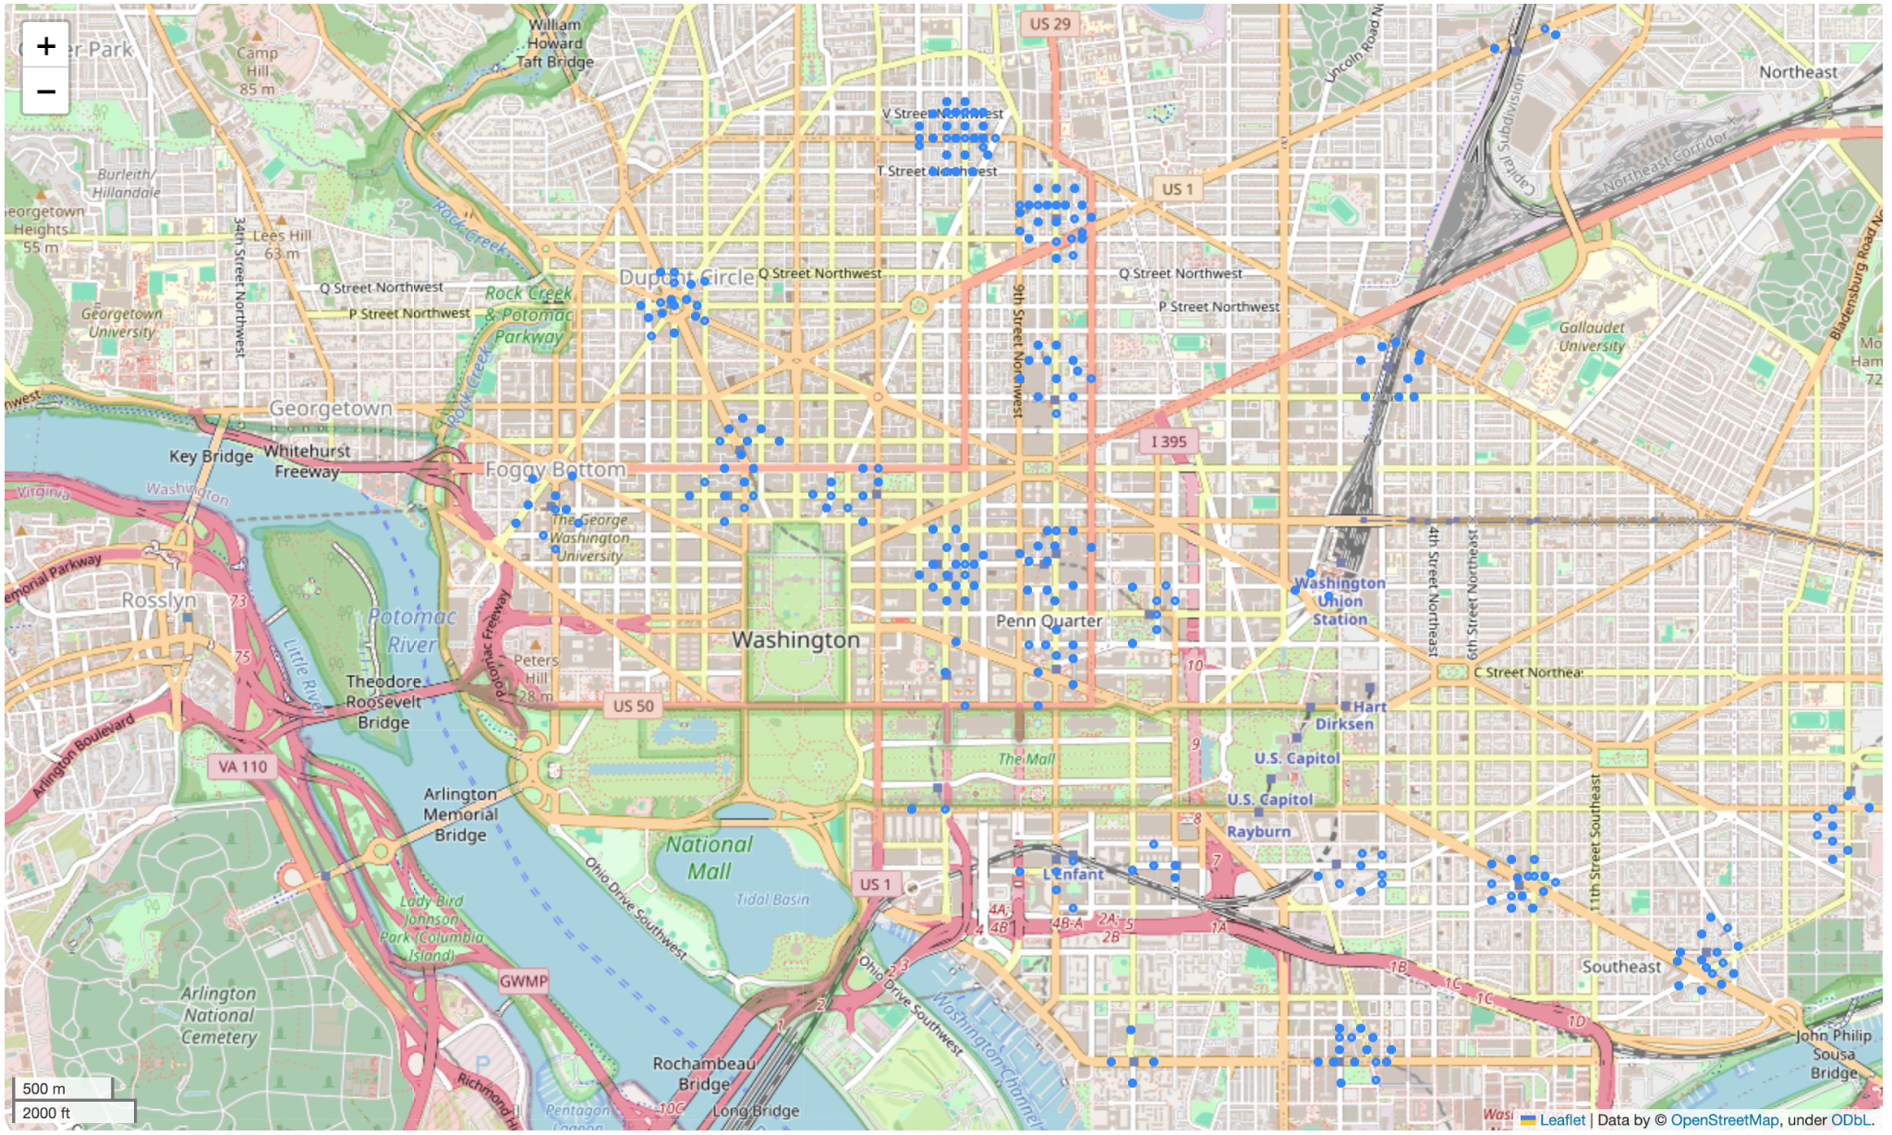
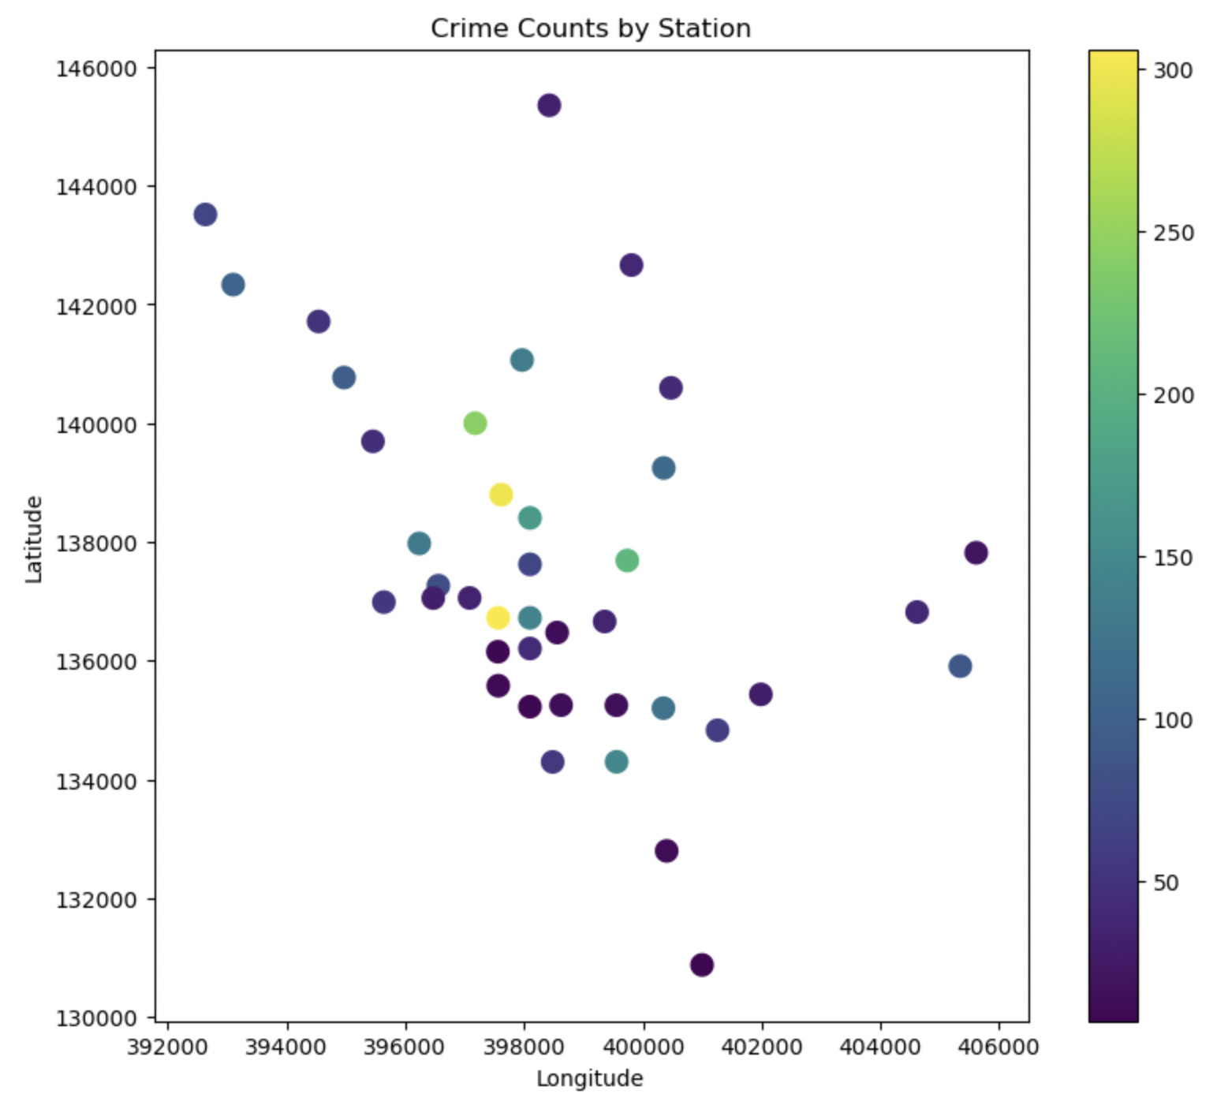
Map Displaying Arrests within 200m of Stations in Downtown Washington D.C.
Correlation Test Result: 0.02
There is negligible correlation between number of trainlines and density of arrests.
However, there are two stations that have a disproportionately high number of arrests, which suggests a need for greater resources in these stations or a change to their design.
Map and Insights on Arrests Within 200m of Metro Stations in Washington D.C. in 2022
Notes:
summarizing the problem, data source, dataset, challenges, map, and insights from visualizing the large dataset

Slide 4
NYPD 911 Calls for Service in 2023
Information on the Dataset
Dataset includes all the calls to the emergency dispatchers in New York City in 2023, over 7 million entries.
It includes a description of the call, whether the call refers to a crime in progress, and, if so, whether the call is critical or not.
Problem
A potential use-case for mapping this data is determining where calls reporting on crimes in progress are located.
This can inform the best areas for education interventions and effective policing.
Challenge
The lack of population data to correlate population density with the number of calls.
The size of the dataset

Slide 5
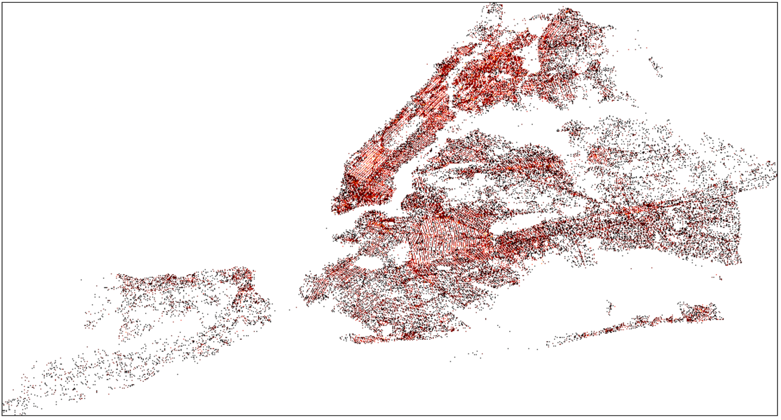
Map Displaying Density of 911 Calls Reporting Crimes in Progress in NYC in 2023
Crimes in progress are most often reported along roads and in Manhattan
Residential areas outside of the city rarely reported crimes in progress
Map and Insights on Calls to NYPD Emergency Dispatcher in 2023
Notes:
summarizing the problem, data source, dataset, challenges, map, and insights from visualizing the large dataset

